Slide 1

What are the factors affecting rent prices for HDB flats in Singapore?
Elicia Foo

Slide 2
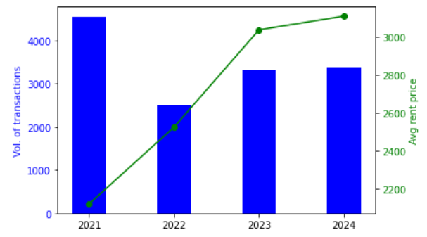
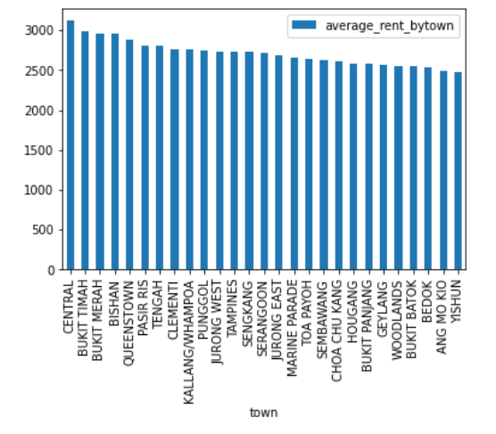
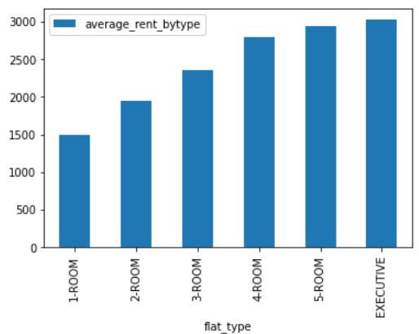
Rental prices seen steadily increasing in the past 4 years
Key findings:
2021 saw an increase in rent volume, likely due to COVID-19 | Rent prices higher in Central Area | Rent prices increases with flat size

Slide 3
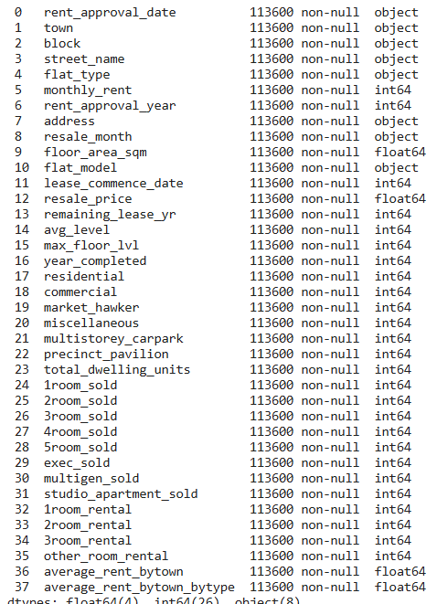




Several models were built to determine which factors affect rent prices in Singapore
$$Y=mx+c$$
#1 Principal Component Analysis (PCA)
#2 Regression
R² = 0.46
#4 XGBoost
#3 Random Forest
R² = 0.43
R² = 0.54
54 variables in final dataset

Slide 4
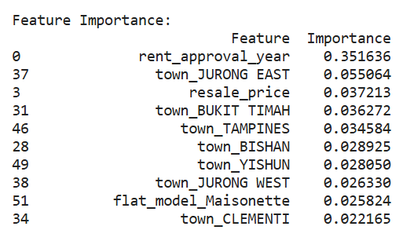
Top features that are found to affect rent prices includes…
Using XGBoost:
Mean Absolute Error (MAE) | 403.96
Mean Squared Error (MSE) | 285363.18
R² score | 0.54

